Slide 1

Sponsor : Chen Jixuan
Express Assistant
Team 20 - Express Assistant

Slide 2
About Our Team
TEAM 20/EA MEMBER
-12301029 Zhao Zijian
-12301031 Chen Jixuan
-12301040 Liu Zhenpeng
-12301172 Qin Shaojian

Slide 3
Why can we have this idea
1.Nowaday express is very popular.More than five hundred millions people need a express in China.And it become more and more.
2.Today's express event have many weak point .It can be better.
Like the existent platform are lack of flexibility,people have to log in official apps of different express companies.

Slide 4
Project Description
1.The Express Assistant is an app based on android platform.
2.It meets the requirement from both consumers and the deliverers from the express company.

Slide 5
Project Description
The program links all express company as well as deliverers together,customers could manage their packages from different origin.
The existent platform are lack of flexibility,people have to log in official apps of different express companies.

Slide 6
Project Description
They can know where the package is at the moment.
The existent platform just can show you the message when the package reach other place.But with our future development.It can show the pakcage like a navigation map

Slide 7
Project Description
Many express company have lots of package that no man receive.It will make the express be more slowly
However,with the help of this app,users who participate in the e-commerce transaction can manipulate their product at any time.

Slide 8
Target People
Students
Office workers
……
all kinds of people who is likely to begin a transaction online

Slide 9
Sponsor : Chen Jixuan
Introduction Of Prototype
Team 20 - Express Assistant

Slide 10
Brief Structure of Use Cases
Homepage with Different Status
Log In
Customer Homepage
Deliverer Homepage
Index
Modify Personal
Information
Register
Package List
(To be Received)
Package List
(Delivery)
Package
Location
Package
Operation
Panel
Abandon
Transaction
Package Detail
Information
Opposite
Character's Info
Confirm
Receiving

Slide 11

Homepage with Different Status
What have been implemented
Log In
Customer Homepage
Deliverer Homepage
Index
History List
History Info
Register
Modify Personal
Information
Package List
(To be Received)
Package List
(Delivery)
Package
Location
Package
Operation
Panel
Abandon
Transaction
Package Detail
Information
Implemented
Opposite
Character's Info
unimplemented
Confirm
Receiving

Slide 12

Prototype Report
Homepage with Different Status
Log In
Customer Homepage
Deliverer Homepage
Listfragment
Index
History List
History Info
Register
Modify Personal
Information
Package List
(To be Received)
Package List
(Delivery)
ListView with adapter
10 XMLs
with
9 Interface
Package
Location
Package
Operation
Panel
Abandon
Transaction
4 Fragments
Package Detail
Information
Opposite
Character's Info
Confirm
Receiving

Slide 13
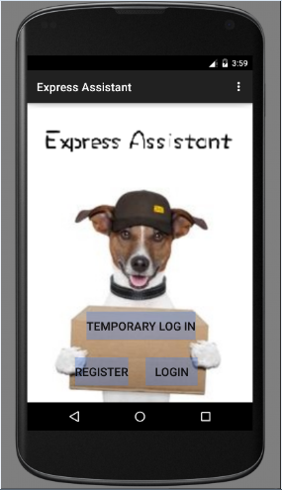
Sponsor : Chen Jixuan
Home Page
The temporary button to
Customer Home Page
These two Use Case
is skipped

Slide 14
Screenshots
Homepage with Different Status
Log In
Customer Homepage
Deliverer Homepage
Index
Modify Personal
Information
Register
Package List
(To be Received)
Package List
(Delivery)
Package
Location
Package
Operation
Panel
Abandon
Transaction
Package Detail
Information
Opposite
Character's Info
Confirm
Receiving

Slide 15
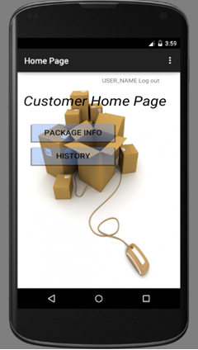
Home Page with Customer status
TomAndoird Logout

Slide 16
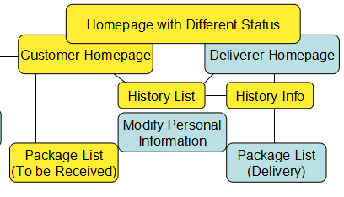
History and sub detail history information
History

Slide 17
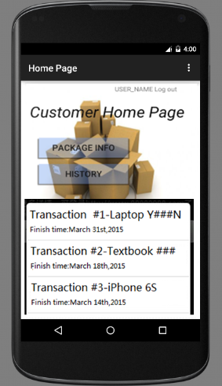
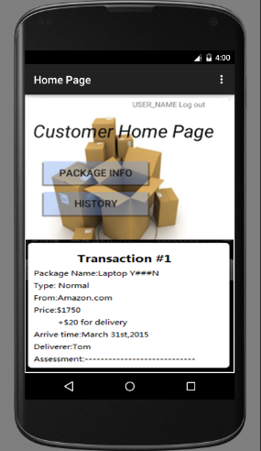
History and sub detail history information

Slide 18
History and sub detail history information
Package List

Slide 19
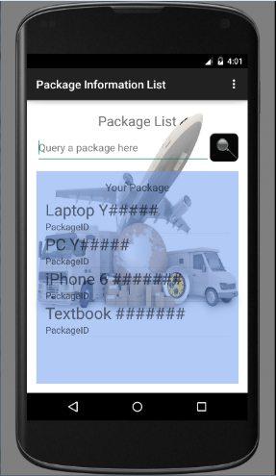
Sponsor : Chen Jixuan
Package List
Query Function
(List Item)Package

Slide 20
Sponsor : Chen Jixuan
Package Operation Panel
Package List
(To be Received)
Package List
(Delivery)
Package Detail
Information
Package
Operation
Panel
Abandon
Transaction
Package
Location
Opposite
Character's Info
Confirm
Receiving

Slide 21
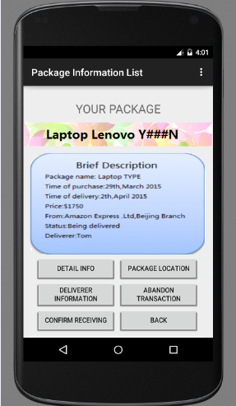
Sponsor : Chen Jixuan
Operation Panel
Package Name
Brief Information
Functions

Slide 22
Sponsor : Chen Jixuan
Package Operation Panel
Package List
(To be Received)
Package List
(Delivery)
Package Detail
Information
Package
Operation
Panel
Abandon
Transaction
Package
Location
Opposite
Character's Info
Confirm
Receiving

Slide 23
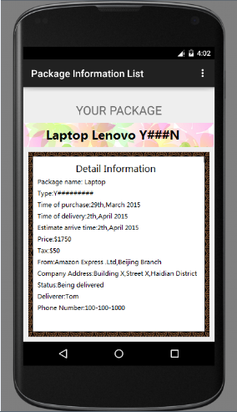
Sponsor : Chen Jixuan
Detail Infomation
Phone Call ——
Short Message——

Slide 24
Sponsor : Chen Jixuan
Package Operation Panel
Package List
(To be Received)
Package List
(Delivery)
Package Detail
Information
Package
Operation
Panel
end
transaction
Send Message
to deliverer
Abandon
Transaction
Check
Package
Location
Update
Deliverer Info
Customer Info
Opposite
Character's Info
Confirm
Receiving
Assessment

Slide 25
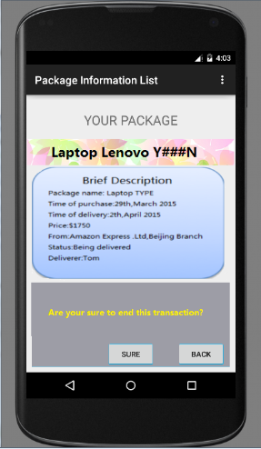
Sponsor : Chen Jixuan
Scenario Performance 1
Abandon Transaction
Need to change date?

Slide 26
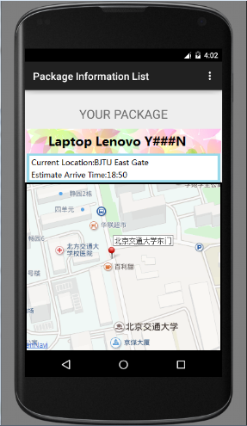
Sponsor : Chen Jixuan
Scenario Performance 2
Package Location
GPS service

Slide 27
Sponsor : Chen Jixuan
Thanks for Listening

